Slide 1

INTRODUCTION

Slide 2
Introduction to Communication
Communication means to create a common understanding. Communication is an important aspect of human behavior.
It stands for natural activity of all human beings to convey opinions, feelings, information, and ideas to others through words (written or spoken), body language, or signs. Communication is an integral part of life.
From birth till death every living being is communicating in his or her own way, be it birds, animals, trees or human beings.

Slide 3
Introduction
○ Communication:
“Communication is the transfer of information, idea, opinion, attitude etc. from a sender to a receiver with a view to making it understandable to the latter.”
According to Gary Dessler, “Communication is the exchange of information and the transmission of meaning”.
According to Elliot Jaquer, “ Communication is the sum total of directly and indirectly, consciously and unconsciously transmitted feelings, attitudes, and wishes”.

Slide 4
Some Definitions of Communication
Accordingly to Murphy and Peck, “Communication is a two-way process of exchanging ideas or information between human beings”.
According to R.S Davar, “ Communication is the process of meaningful interaction among persons in an organization, resulting in meanings being perceived and understandings effected among such persons”.

Slide 5
Business communication
The word Business stands for any economic activity undertaken with a view to earn profit.
The communication undertaken in the process of this activity is termed as business communication.
From the very inception of the idea of the Business, to run the day to day activities of the Business, communication is involved. It includes oral, written, formal, informal, upward, downward, lateral, diagonal, inward outwards as well as non verbal communication.

Slide 6
Business communication
Business communication is information sharing among people within and outside an organization that is performed for the commercial benefit of the organization.
In addition, business communication can also refer to how a company shares information to promote its product or services to potential consumers.

Slide 7
Communication - The life blood of an organization
Communication is often referred to as the lifeblood of a business organization because it serves as the vital conduit through which information, ideas, and instructions flow. Here's why it's considered so crucial:
Coordination: The achievement of organizational objectives largely depends upon a proper co-ordination and integration of human effort in an organization. The people working in an organization are interrelated; their activities are also interrelated because all activities are performed only to achieve the organizational objectives. Co-ordination and integration of various human activities are possible only if there is an effective system of communication in the organization which provides for exchange of information and sharing of various ideas. The more effective the system of communication, the better is the relation between workers and the management.

Slide 8
Decision Making: Good communication ensures that relevant information reaches decision-makers in a timely and accurate manner. This enables informed decision-making, which is essential for the smooth functioning and success of any business.
Problem Solving: When issues arise, clear communication is essential for identifying, understanding, and resolving them efficiently. It allows for open dialogue, brainstorming, and collaboration to find effective solutions.
Employee Engagement: Transparent and open communication fosters trust and engagement among employees. It helps them feel valued, informed, and connected to the organization's mission and vision, which can boost morale and productivity.

Slide 9
Customer Relations: Communication is not limited to internal interactions; it's equally important for maintaining relationships with customers and clients. Clear communication builds trust, enhances customer satisfaction, and fosters loyalty.
Innovation and Adaptation: Effective communication encourages the sharing of ideas and feedback, which is essential for innovation and adaptation to changing market conditions. It creates an environment where creativity can flourish and new opportunities can be explored.
Conflict Resolution: Conflicts are inevitable in any organization, but effective communication can help manage and resolve them constructively. It enables parties to express their concerns, listen to each other's perspectives, and find mutually acceptable solutions.

Slide 10
Effective Communication
Effective communication definition is the process of exchanging or transmitting ideas, information, thoughts, knowledge, data, opinion, or messages from the sender through a selected method or channel to the receiver with a purpose that can be understood with clarity.

Slide 11
Elements of Communication
Sender:
● One who sends the message is the sender.
● Sender send a message either the writer or speaker, depending upon whether the communication is written or oral. Sender is the encoder of the message. Message include symbols, usually words that will correctly and tactfully express the message. So, the receiver will understand it and react with desired response. Both internal and external stimuli affect message encoding and sending.

Slide 12

Elements of Communication
Message:
● The sender translates his ideas into a message.
● The message may consist of both verbal, written or spoken symbols and nonverbal symbols to convey ideas from the sender to the receiver.
Please read me

Slide 13
Elements of Communication
Channel:
● The medium used to convey the message is the channel.
● The choice or medium is influenced by the inter relationship of sender and receiver.
● If the message requires an immediate answer or if it contains bad news for the receiver an oral channel may be the better choice.
● If the message contains complicated details and figures or if its subject requires filing for future reference, a written communication is necessary.

Slide 14
Elements of Communication
Receiver:
● The message receiver is the reader or listener and decoder of the message.
● The receiver as well as he sender are influenced by external environment and internal stimuli.
● A problem is that all of us do not have identical experience with the subject or the symbols a sender uses.
● Attitudes, abilities, opinions, communications skills, and cultural customs of receiver and sender of message usually vary.

Slide 15

Elements of Communication
Ultimately the receiver reacts, either with a response based on clear interpretation of the symbols or an incorrect response because of miscommunication

Slide 16
Elements of Communication
Feedback:
● Feedback is the receiver’s reaction.
● Receiver’s reaction indicating to the sender whether or not the message has been understood and correctly interpreted.
● Feedback creates a two way process of communication rather than a simple send receive relationship.

Slide 17
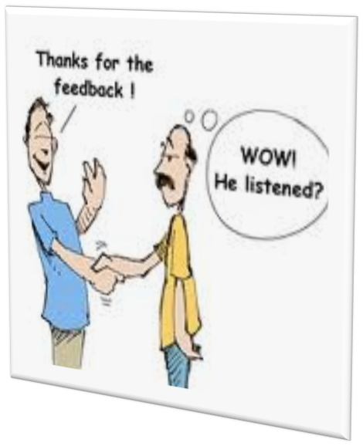
Elements of Communication
● Feedback may be a simple ”yes” or “No” or a request for further clarification.
● If the receiver incorrectly perceives the message, that is miscommunication.
● The success or failure of the communication is indicated by the feedback.

Slide 18


